Slide 1

Texas A&M Accessible Routes Web-Map
By: Lauren Rogers

Slide 2
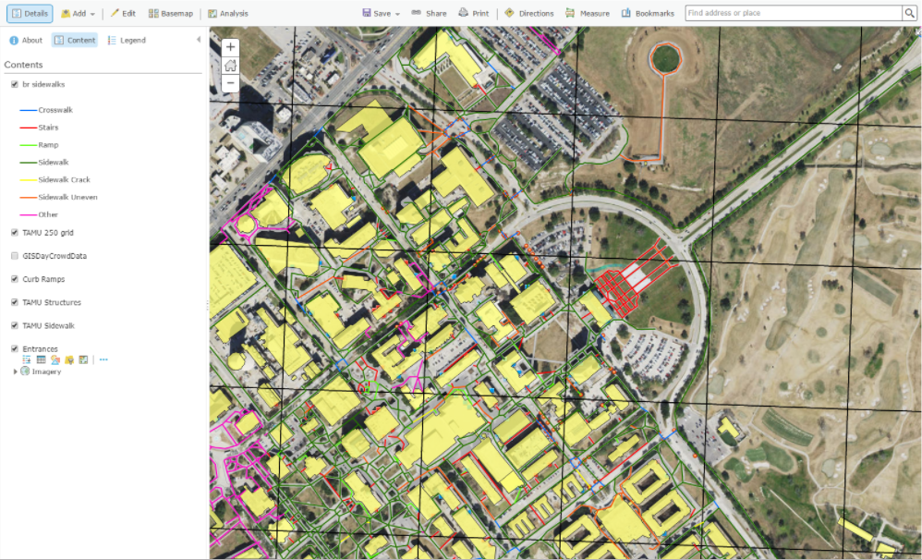
Project Goals
Clean up current sidewalk layer
Integrate sidewalk layer into a web-map

Slide 3
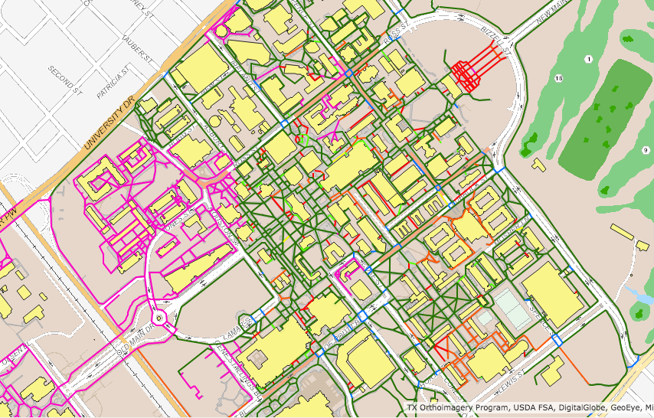
Approach
Worked with the sidewalk layer in ArcGIS Online
Created the web-map in ArcGIS Online

Slide 4
Challenges
Sidewalk statuses were not verified before the project began
ArcGIS Pro

Slide 5
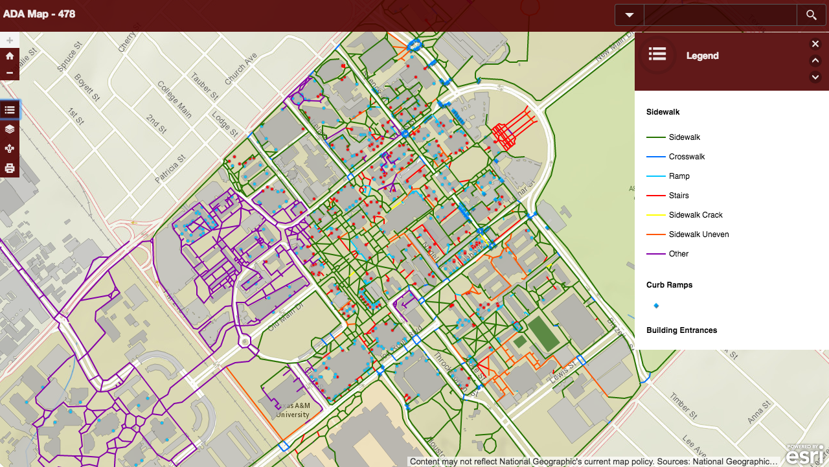
Working Demo
Demo Map

Slide 6
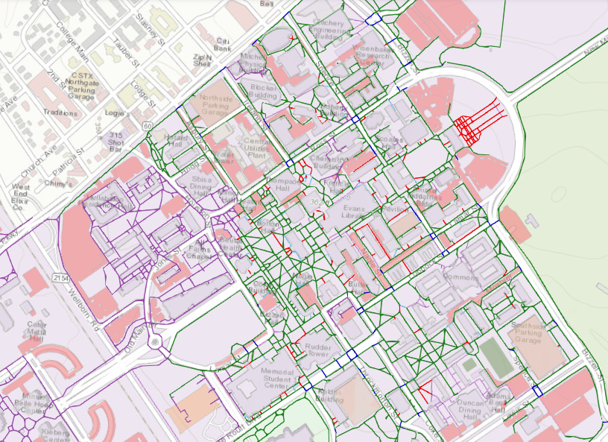
Customer Feedback
The customer was satisfied with the end result

Slide 7
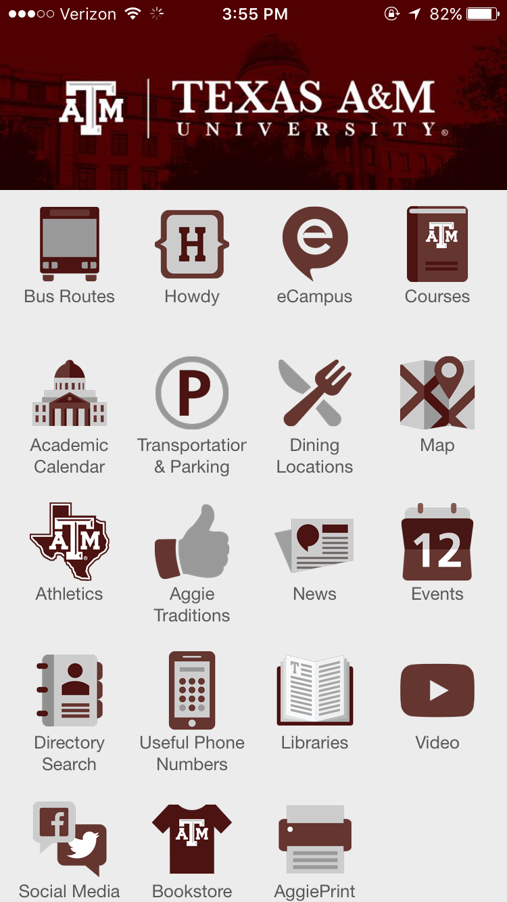
What Now?
The sidewalk data will be handed off to Dr. Goldberg
The sidewalk layer will be comprehensively recollected in the future

Slide 8

Questions?
Lauren Rogers | Lrogers29@tamu.edu

